Slide 1

USLM 2.0

Slide 2
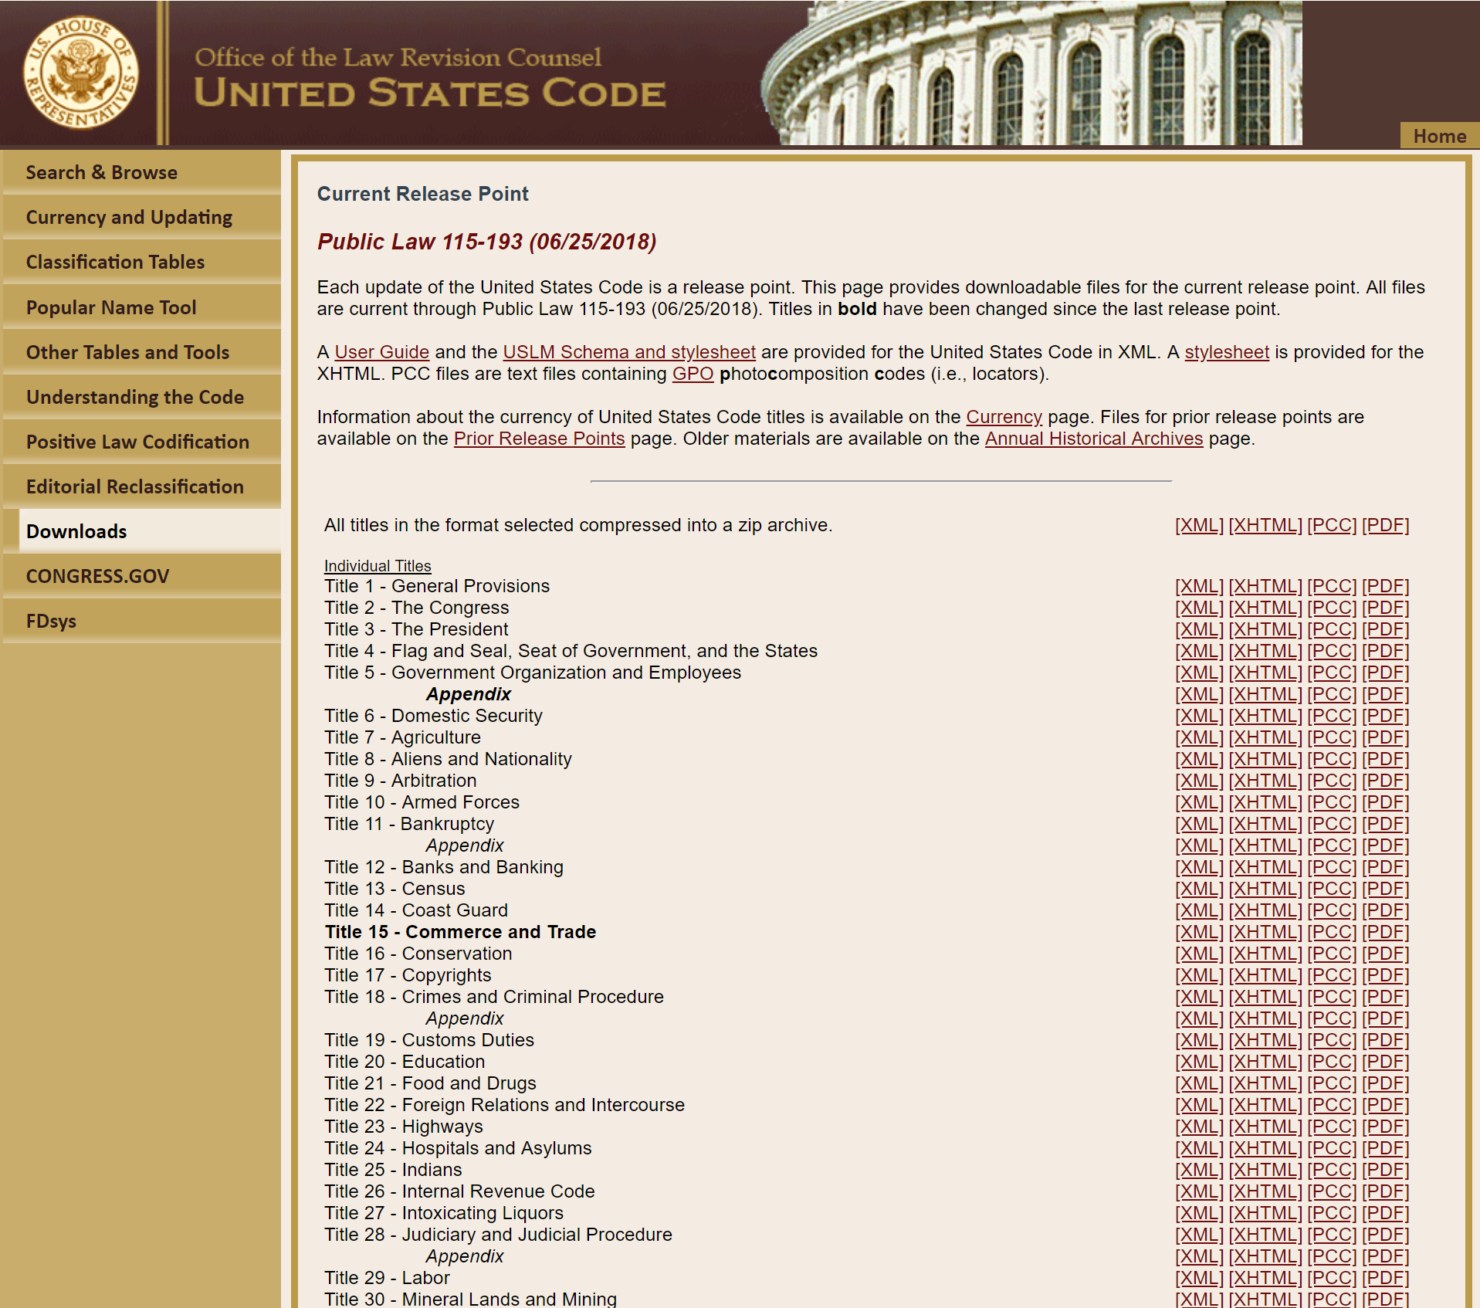
USLM 1.0
Developed in 2013 for the OLRC
Based Akoma Ntoso
Supports U.S. Code
  54 Titles
  5 Appendices
Positive law title drafting
U.S. Code maintenance
(prototype )

Slide 3
Design Principles
Well-defined Semantic Model
Specific Elements
  uscDoc
  bill /plaw
  statutesAtLarge
  frDoc
  rule
  notice
  presidentialDoc
  cfrDoc
Basic Types
Block
Inline
Content
Marker
Semantic Types
LawDocType
PrefaceType
LevelType
NoteType
Generic Elements
lawDoc
preface
level
note
Specific Elements
  title
  chapter
  part / subpart
  section
  subsection
  paragraph
Model
Tagging

Slide 4
Design Principles
Consistent Identity and Referencing
    Identity: <paragraph identifier="/us/cfr/t40/s2.107/j/1“>
    Reference: <ref href="/us/cfr/t40/s2.107/j/1“>
Examples:
    USCode /us/usc/t1
    Bill /us/bill/115/hr/255
    PublicLaw /us/pl/92/403
    StatutesAtLarge /us/stat/123/218
    Federal Register /us/fr/78/67800
    CFR /us/cfr/t34/p685
    Constitution /us/cons/aI/s8/11
    Executive Order /us/eo/1425

Slide 5
Design Principles
Use existing standards
  Dublin Core
  XHTML Tables
  External Namespaces (e.g. MathML)
  Akoma Ntoso principles
More permissive than necessary
All doc content is explicit

Slide 6
USLM 2.0 Goals
Extend USLM to support more
of the legislative and regulatory process:
  Enrolled Bills
  Public & Private Laws
  Statutes at Large
  Federal Register
  Code of Federal Regulations
  Concept Tagging
  Support Print Composition

Slide 7
USLM 2.0 Change Summary
New Models
  Preface & Back Matter
  Collections
New Document Elements
Modified Models
  ToC
  Notes
Other Changes

Slide 8
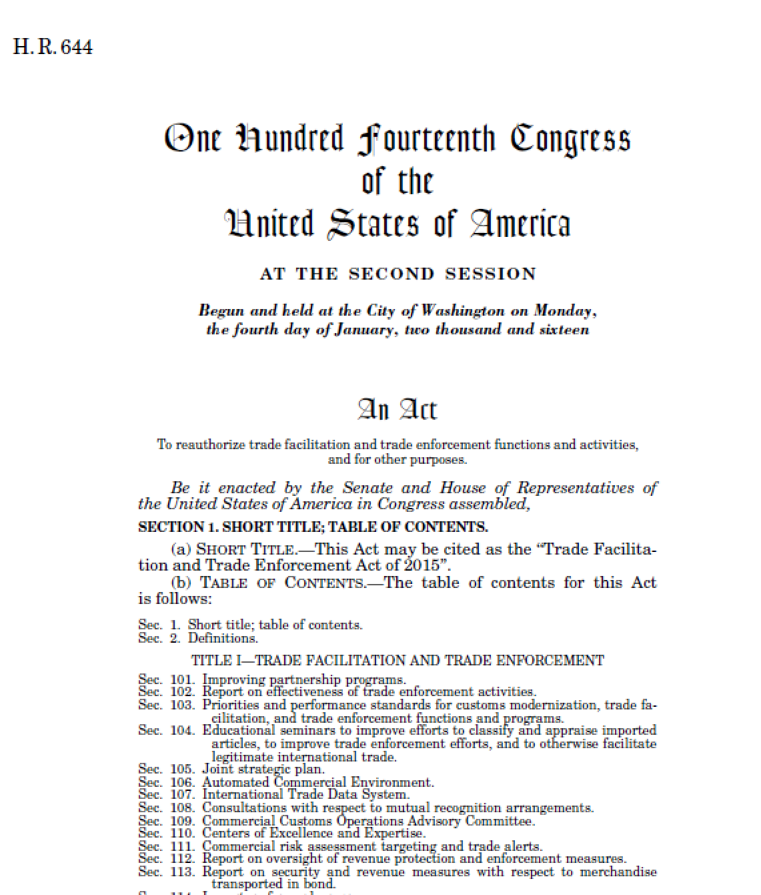
New Document Model
meta
  not rendered
  canonical form
preface
  rendered
main
notes / signatures
backMatter
endMarker
appendix

Slide 9
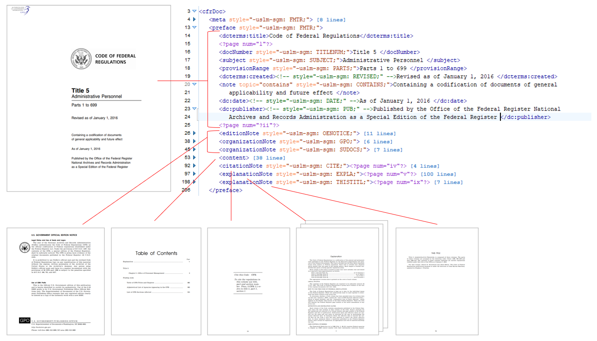
New Document Model
meta
  not rendered
  canonical form
preface
  rendered
main
notes / signatures
backMatter
endMarker
appendix

Slide 10
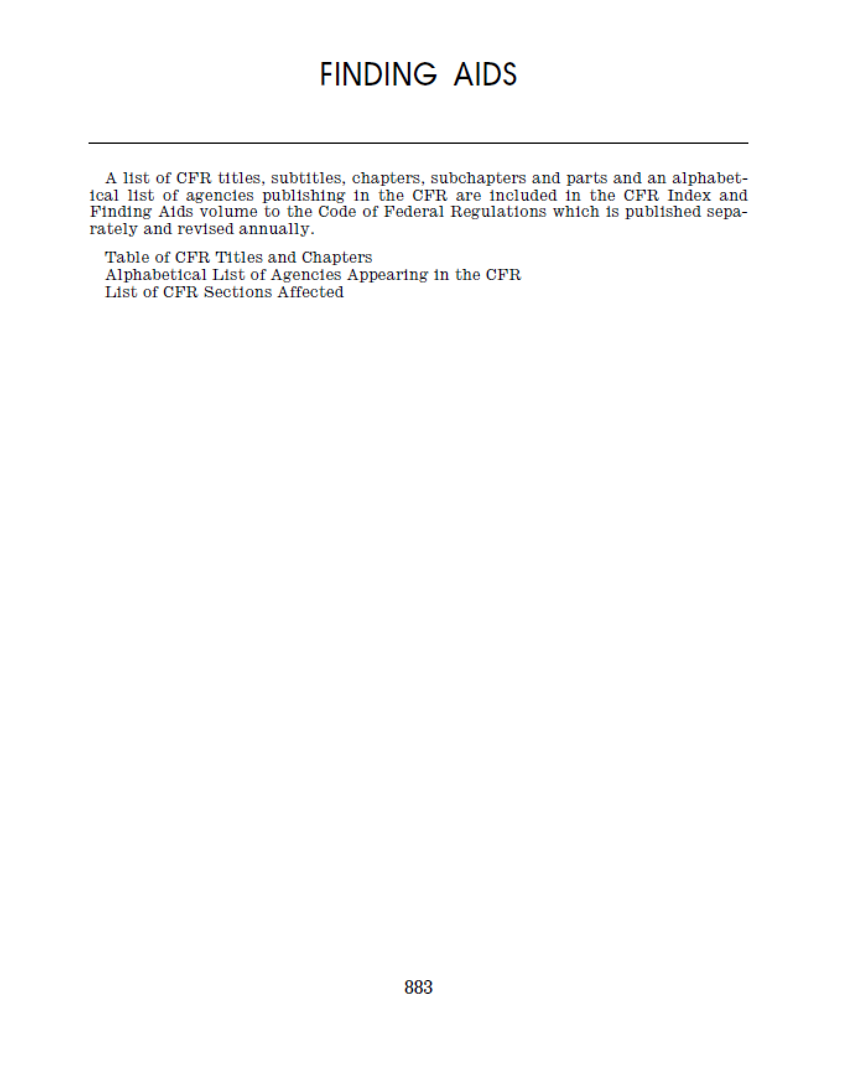
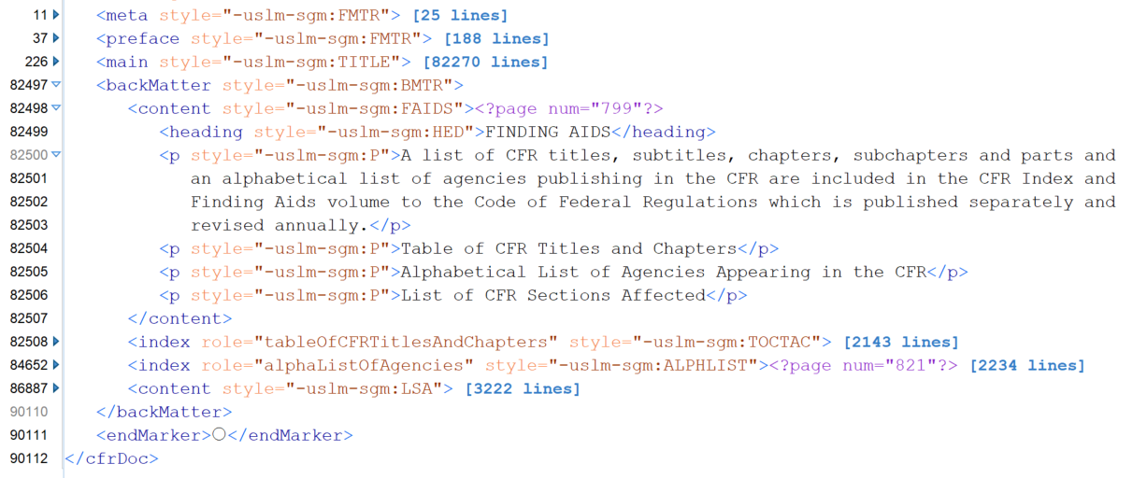
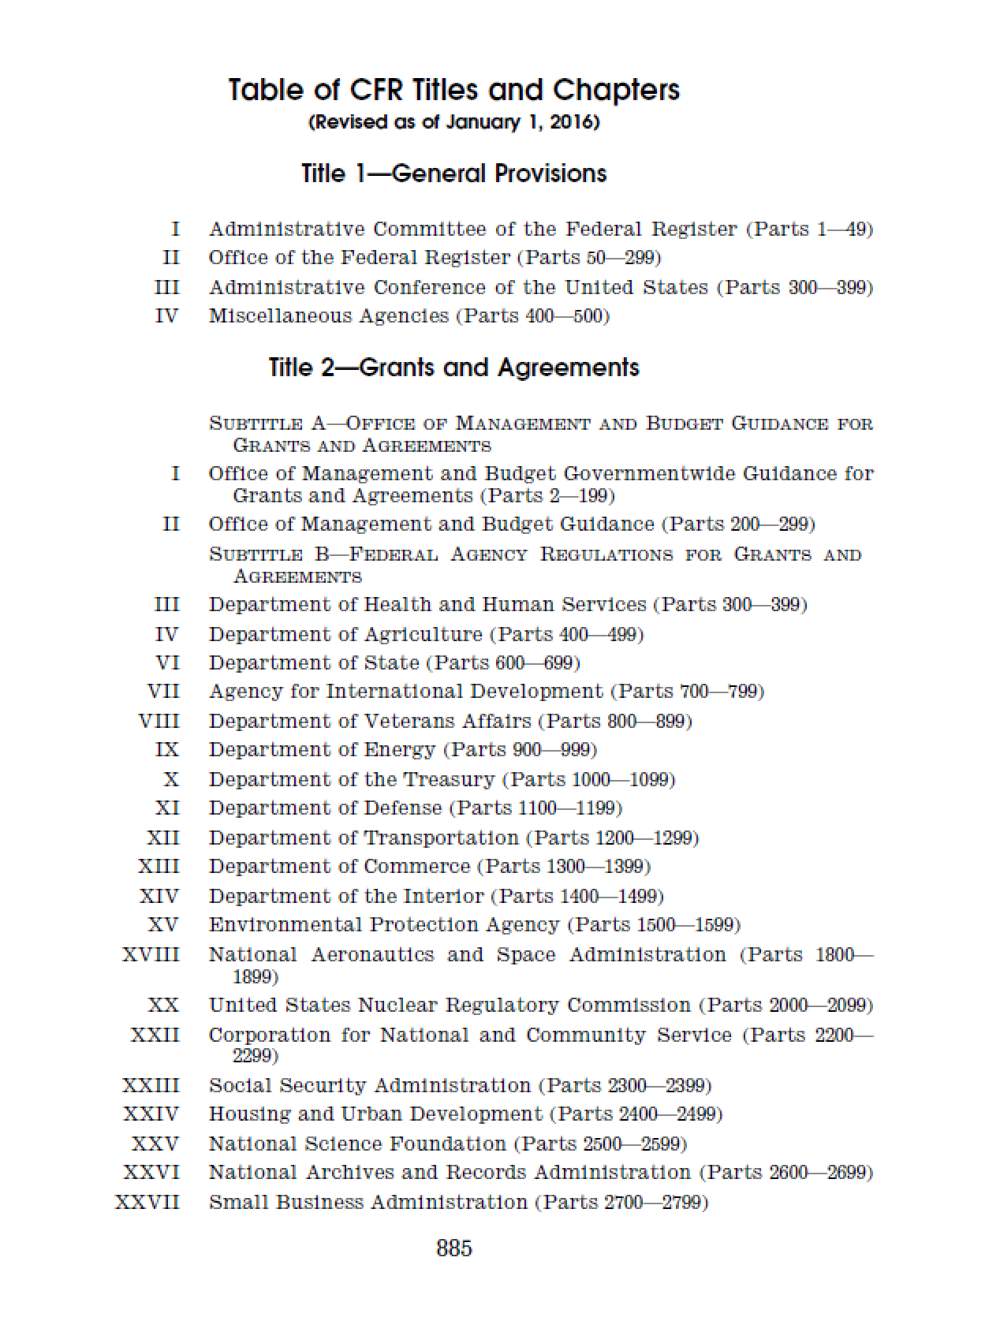
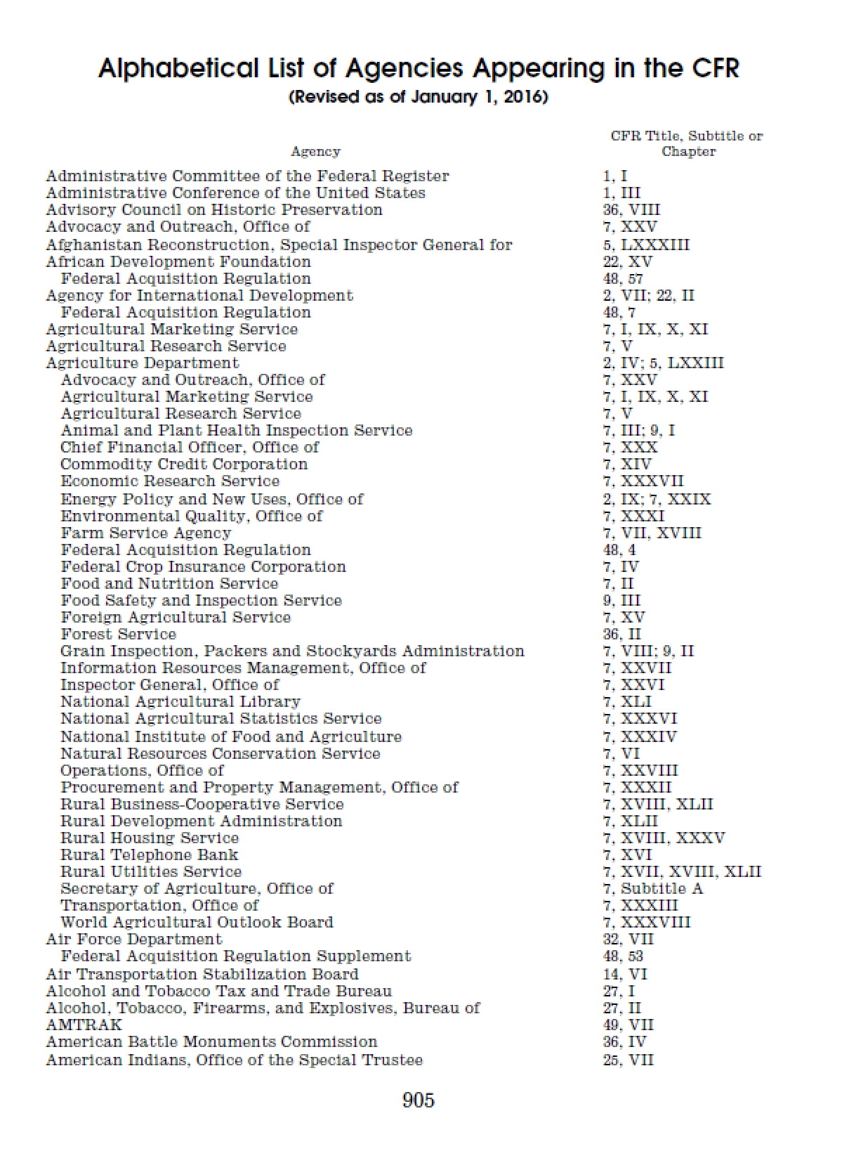
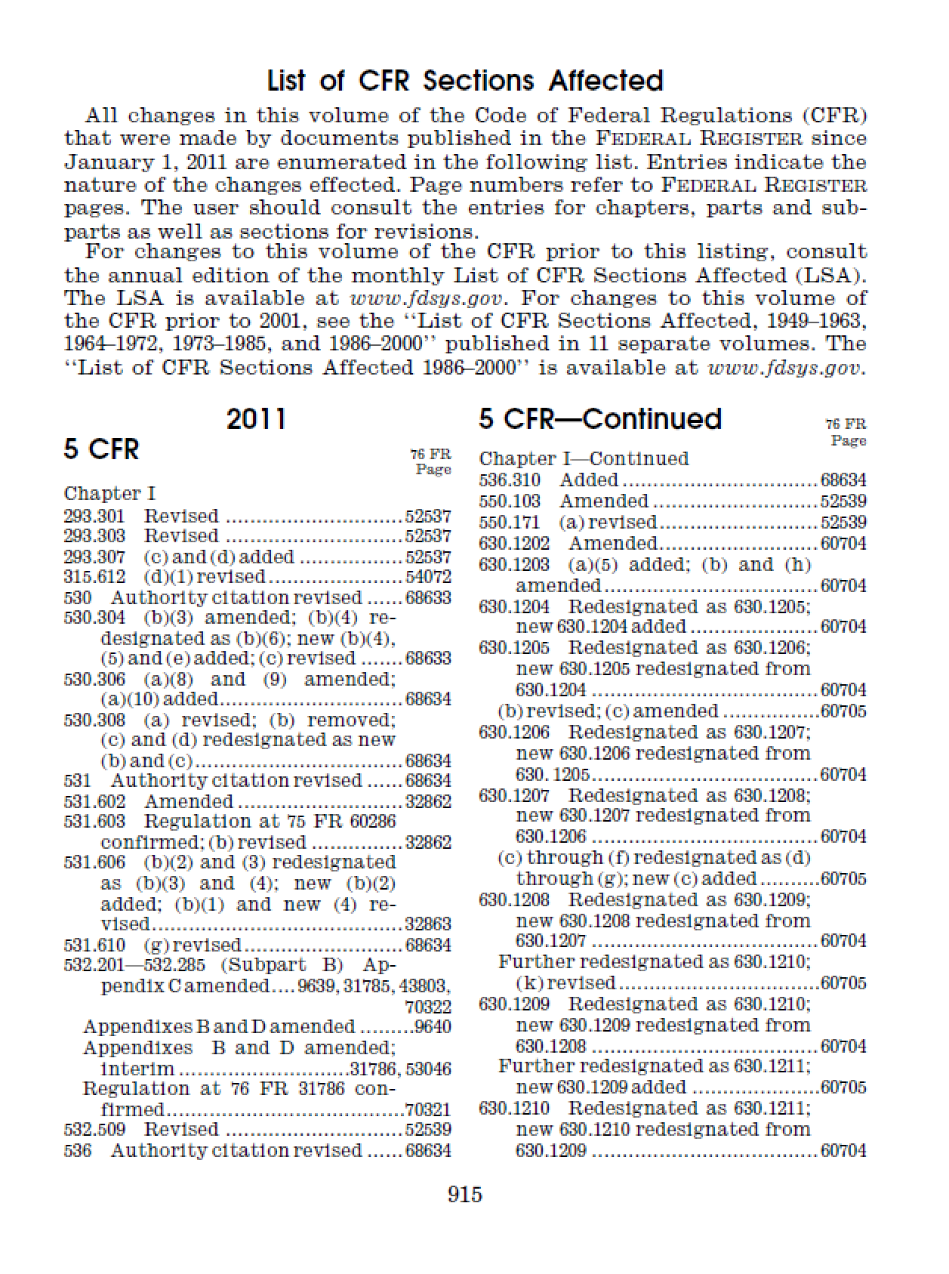
New Document Model
meta
  not rendered
  canonical form
preface
  rendered
main
notes / signatures
backMatter
endMarker
appendix

Slide 11
New Document Elements
pLaw
statutesAtLarge
frDoc
cfrDoc
rule
notice
presidentialDoc

Slide 12
Collections
For collections of documents within other documents
Statutes at Large
  publicLaws, privateLaws
  concurrentResolutions
  presidentialDocs
Federal Register
  notices
  rules, proposedRules
  agencyGroup
  presidentialDocs

Slide 13
ToC
Old Model
Format oriented - tables
Single level
ToC’s only
Key Elements:
  layout => table
  tocItem => row
  column => cell
New Model
Semantic oriented - items
Nested
Supports Indices
Key Elements:
  referenceItem designator
  headingItem label
  groupItem target

Slide 14
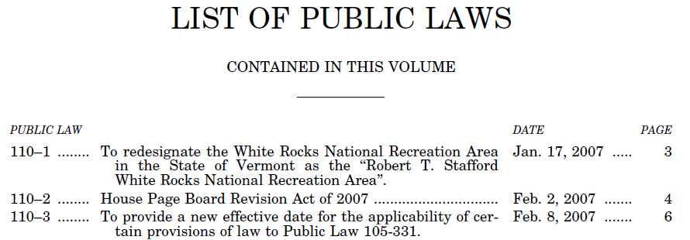
ToC Example
headingItem
referenceItem
designator
label
label
target

Slide 15
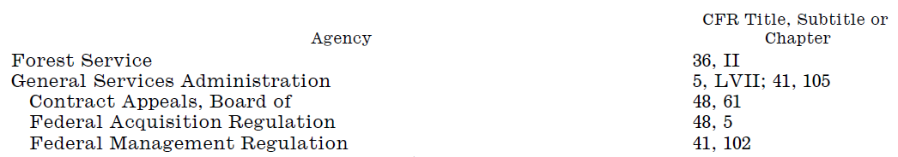
Index Example
headingItem
groupItem
referenceItem
label
target

Slide 16
New Index Elements
Statutes at Large
listOfBillsEnacted
listOfPublicLaws
listOfPrivateLaws
listOfConcurrentResolutions
listOfProclamations
popularNameIndex
subjectIndex
CFR
tableOfTitlesAndChapters
listOfAgencies
listOfSectionAffected
Generic
index

Slide 17
Notes
Old Model
Note Types
  inline
  footNote
  endNote
  uscNote
@topic attribute
New Model
Note Types
  Note – rendered in the main content flow
  PositionedNote – rendered at a defined position
@topic attribute remains
@renderingPosition attribute added

Slide 18
NoteType
note (generic)
sourceCredit (usc)
source (fr/cfr)
uscNote
statutoryNote
editorialNote
changeNote
authority
effectiveDateNote
frDocId
billingCode
editionNote
organizationNote
citationNote
explanationNote
findingAidsNote

Slide 19
PositionedNoteType
footnote
sidenote
endnote
leftRunningHead
rightRunningHead
ear
endMarker
page
line

Slide 20
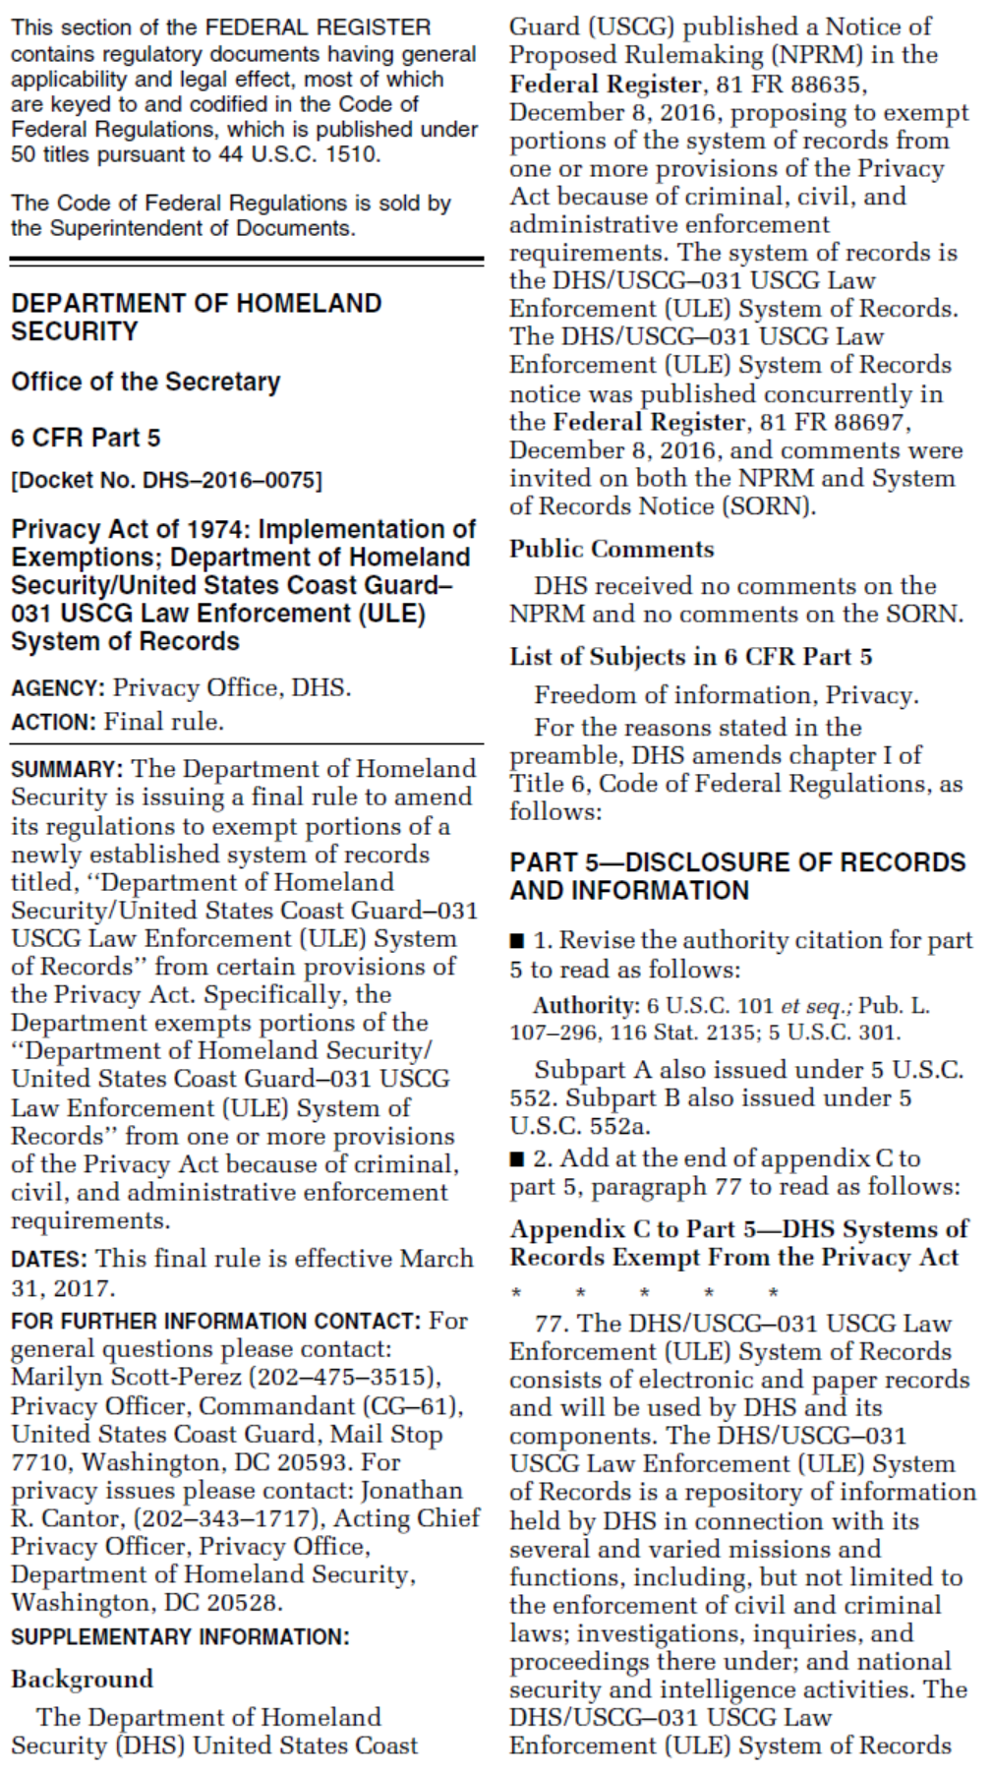
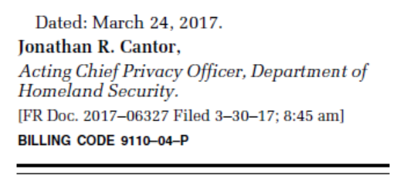
Rule Document
preface
  organization
  affected
  subject
  action
main
  rulePreamble
    statement(s)
      summary
      effectiveDate
      furtherInfo
      suplInfo
      listOfSubjects
    wordsOfIssuance
  section(s)
  frDocId
  billingCode
page
line

Slide 21
Other Changes
Concept Tagging
  NAICS Codes, SIC Codes, Incorporation by Reference
XHTML tables
  Now allows USLM content and attributes
Amendments
  Refined components (e.g. amendingAction)
Definitions
  Refined components (e.g. term, scope)
General
  Expanded content models to allow more variations (e.g. note, page)

Slide 22
Sample Documents
Enrolled Bills
Public Law
Statutes at Large
Federal Register
Code of Federal Regulations

Slide 23
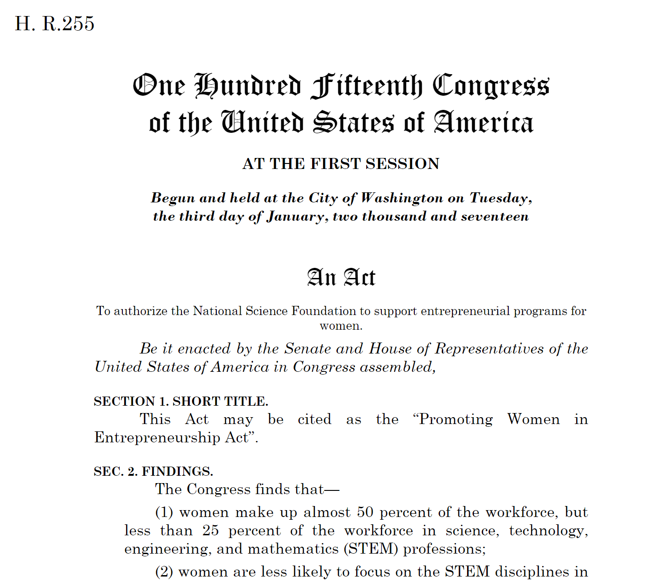
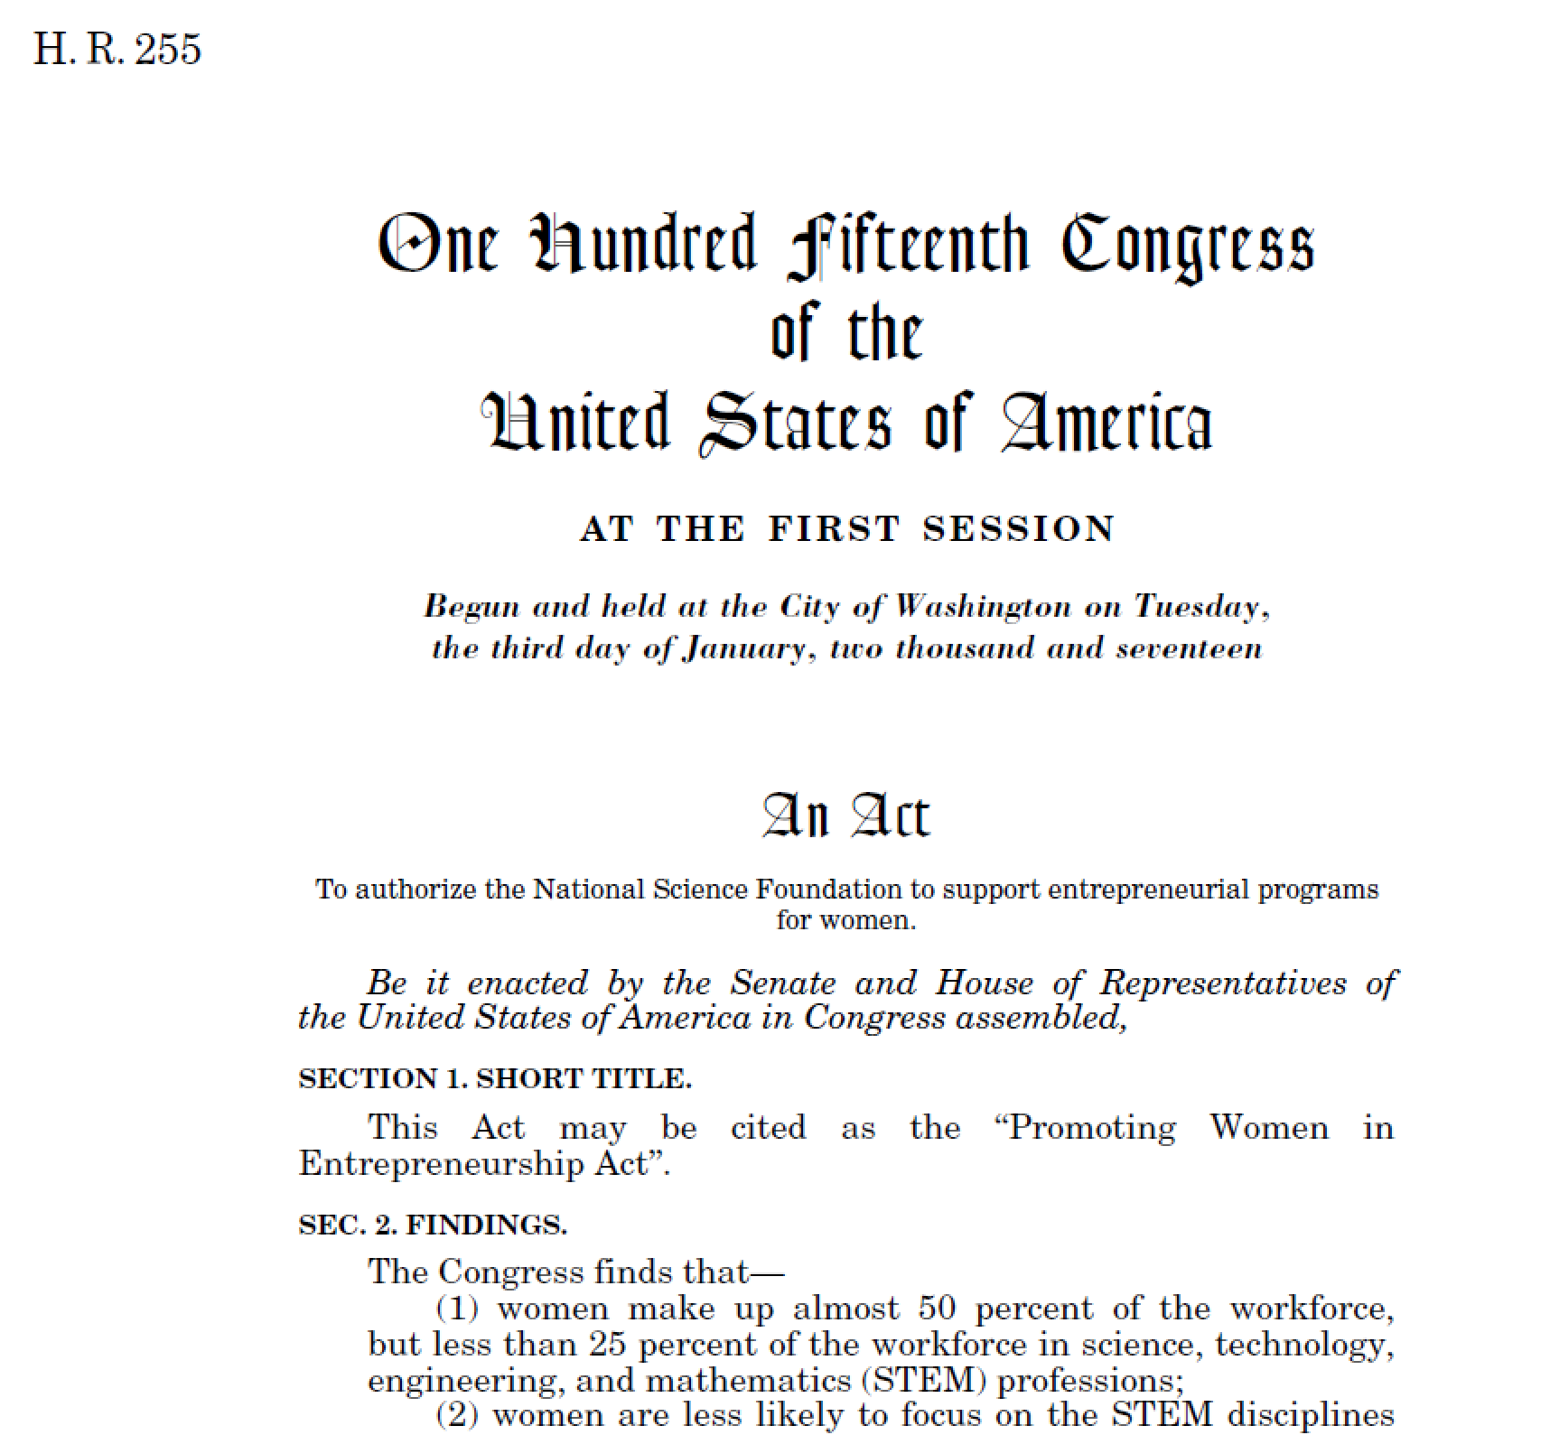
Enrolled Bills

Slide 24
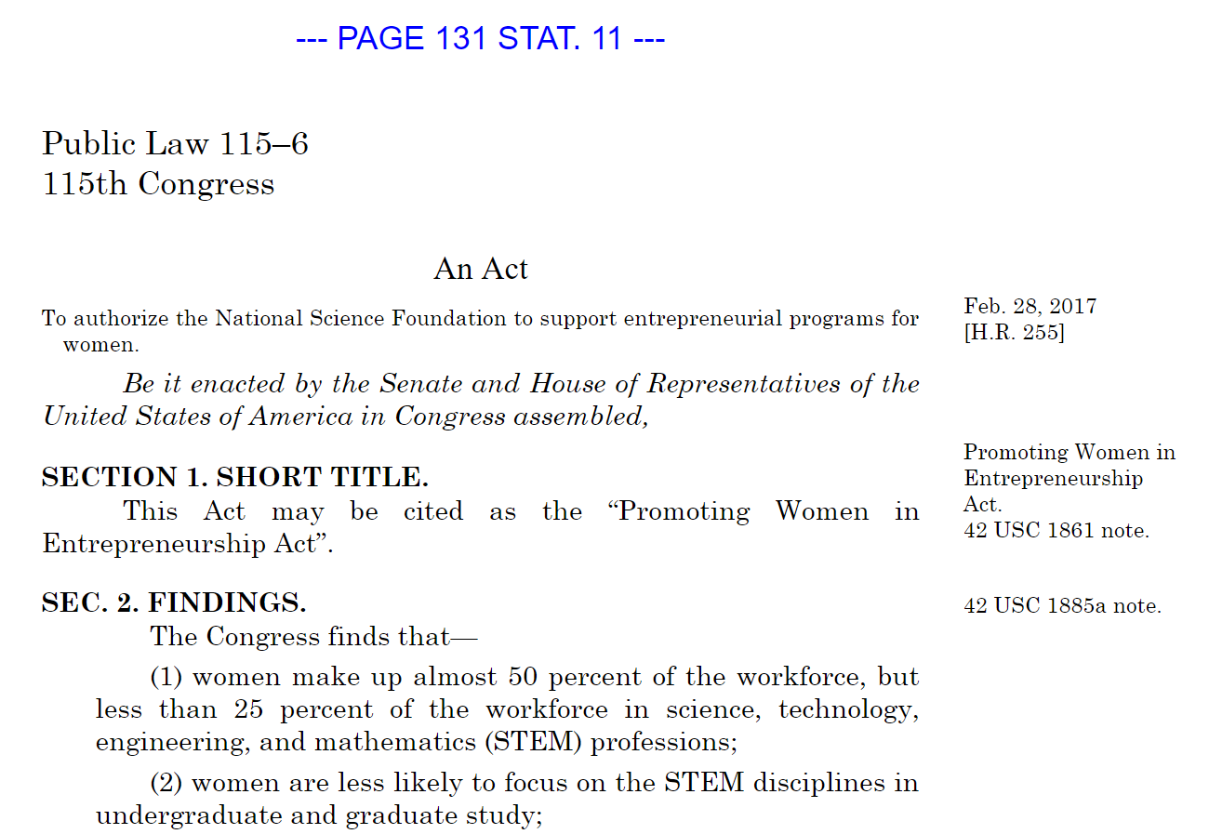
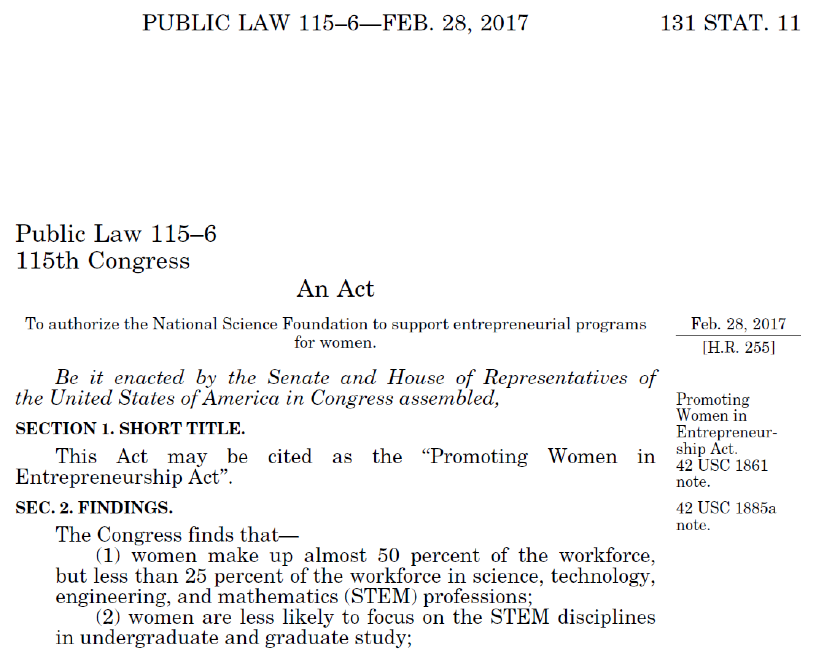
Public Law

Slide 25
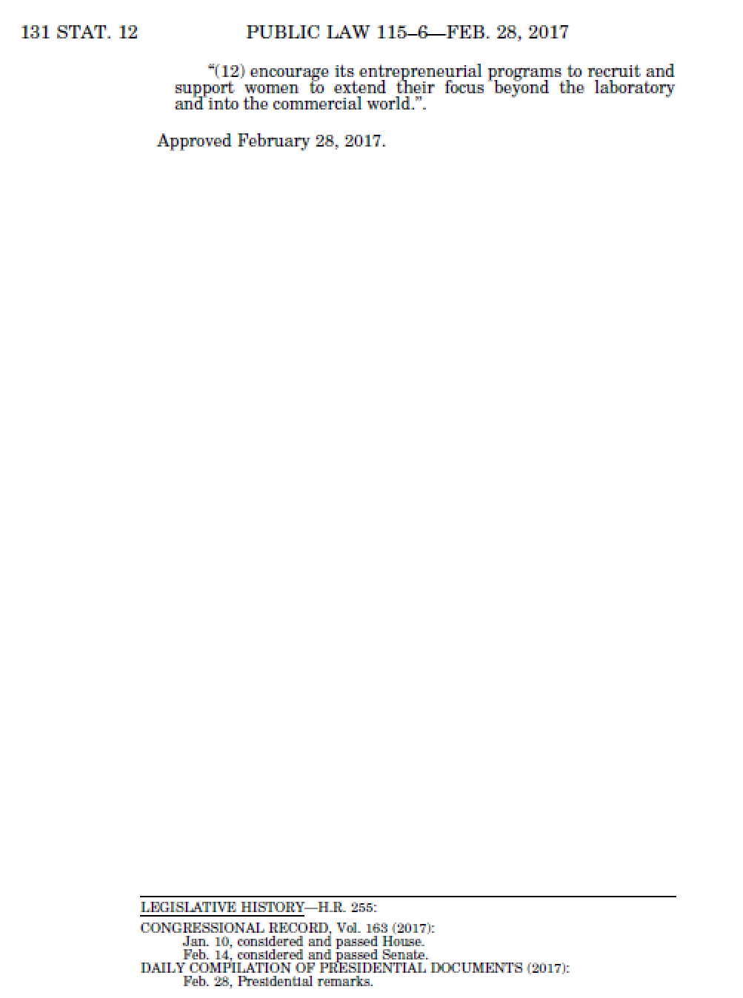
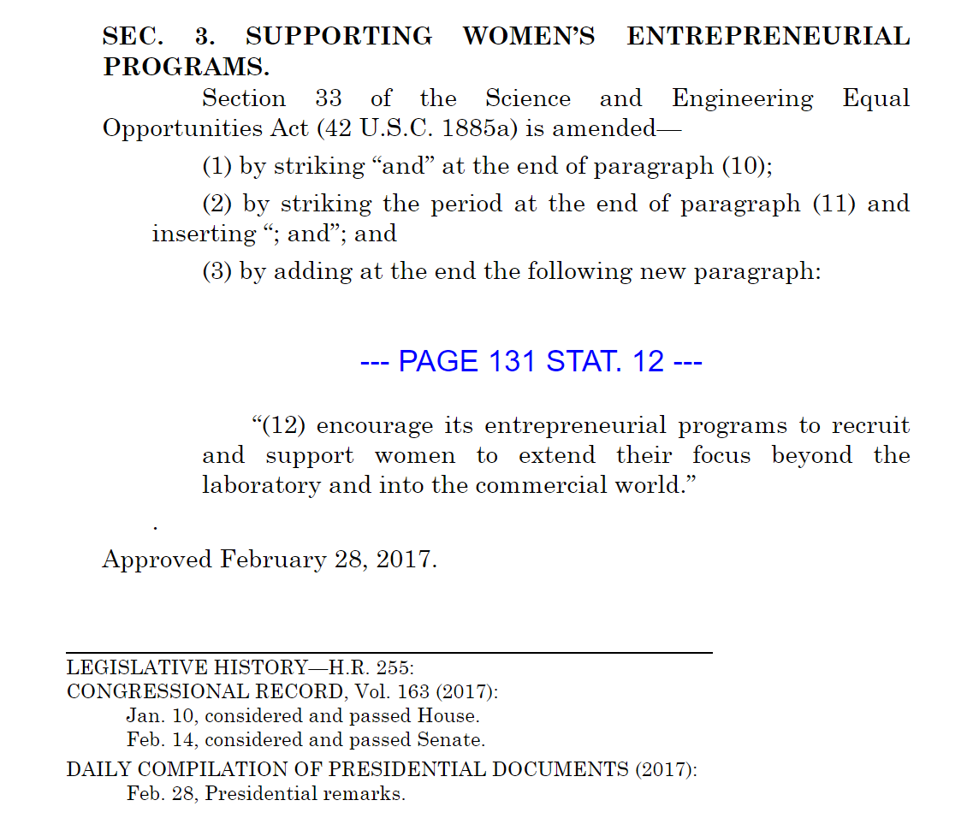
Public Law

Slide 26
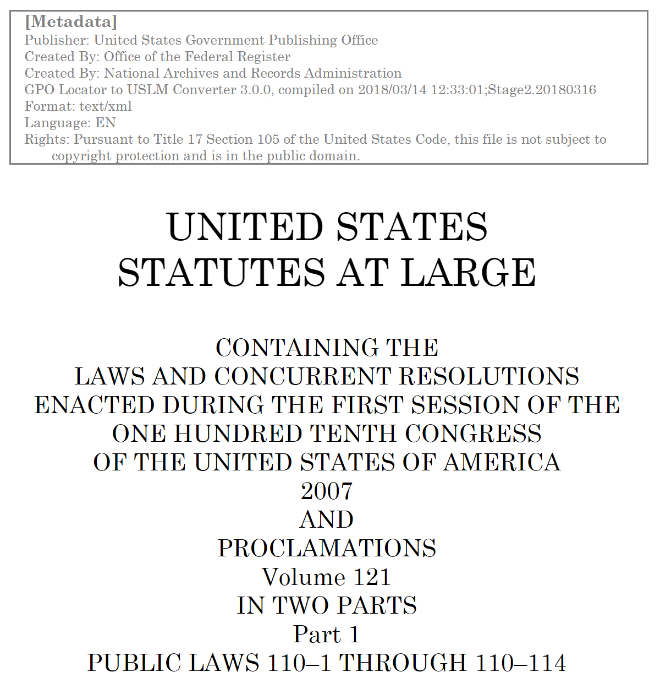
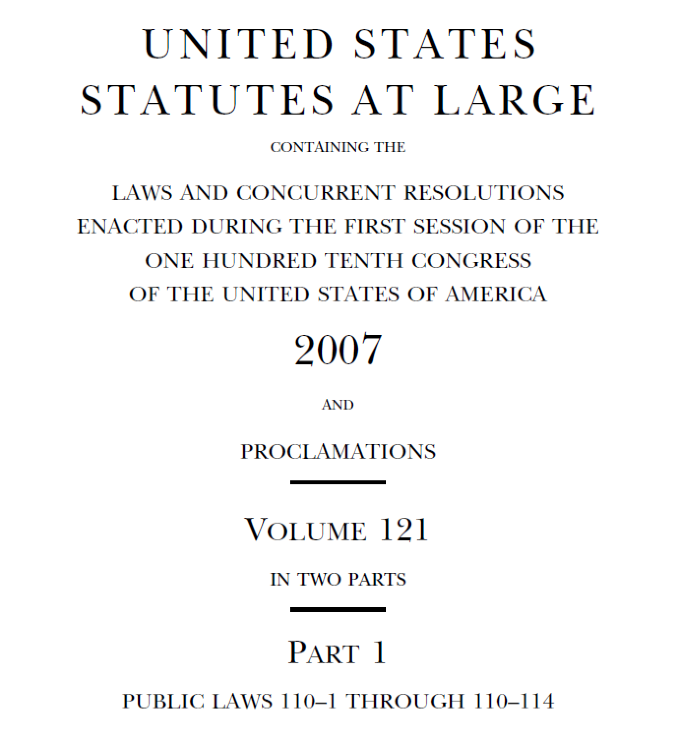
Statutes at Large

Slide 27
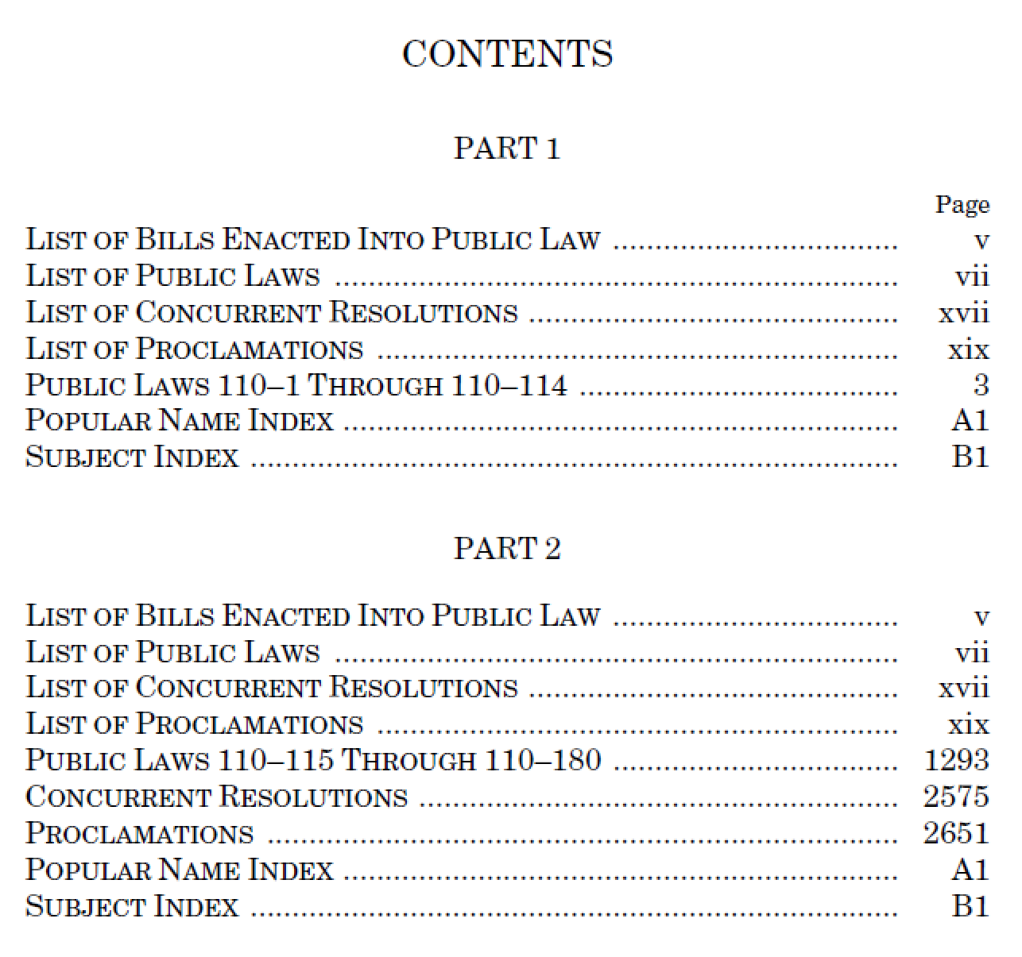
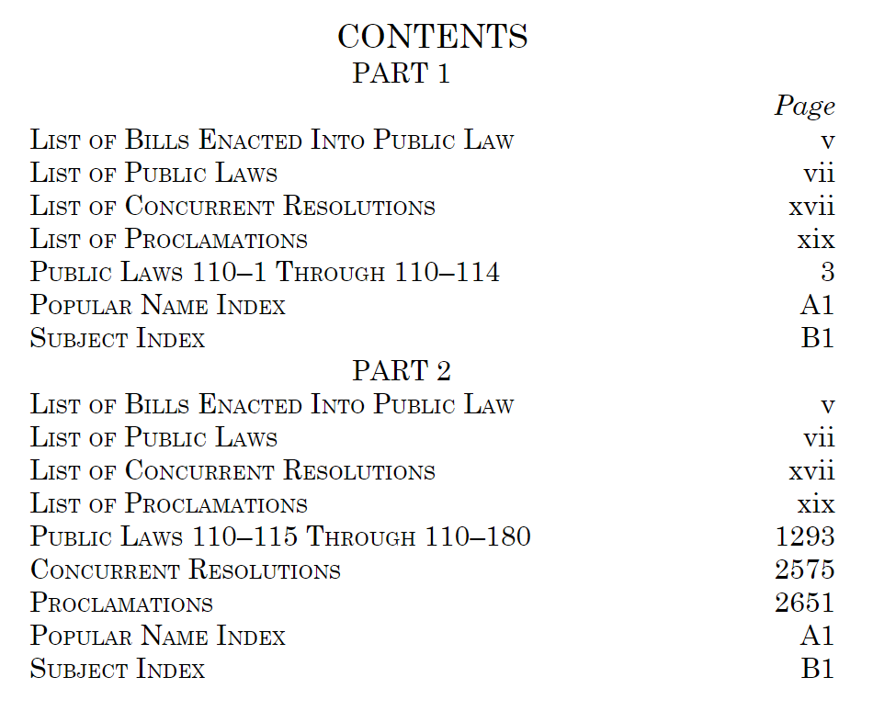
Statutes at Large - ToC

Slide 28
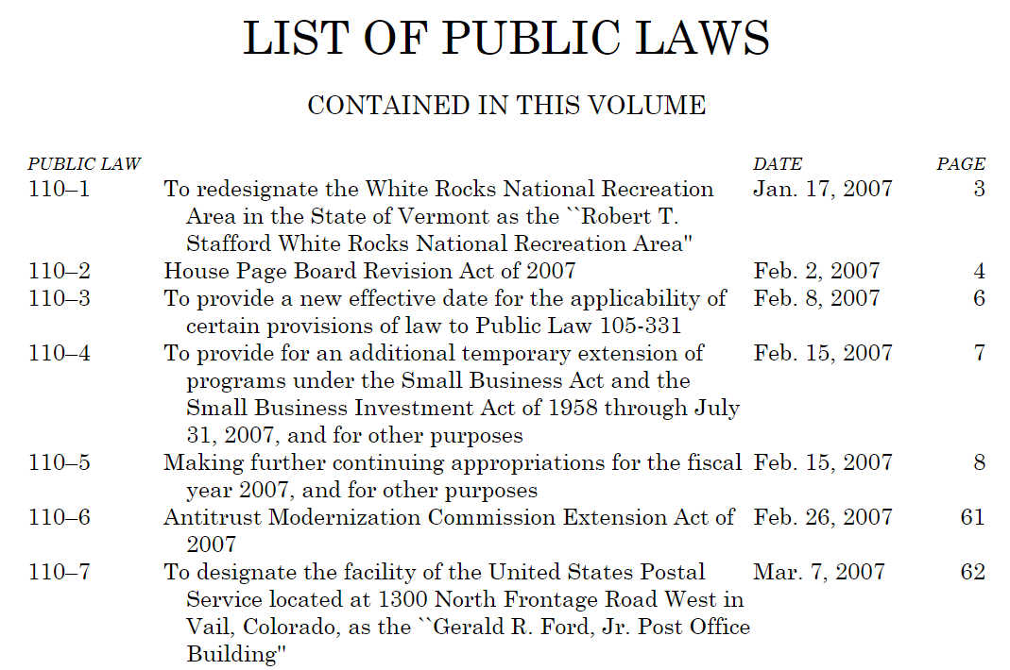
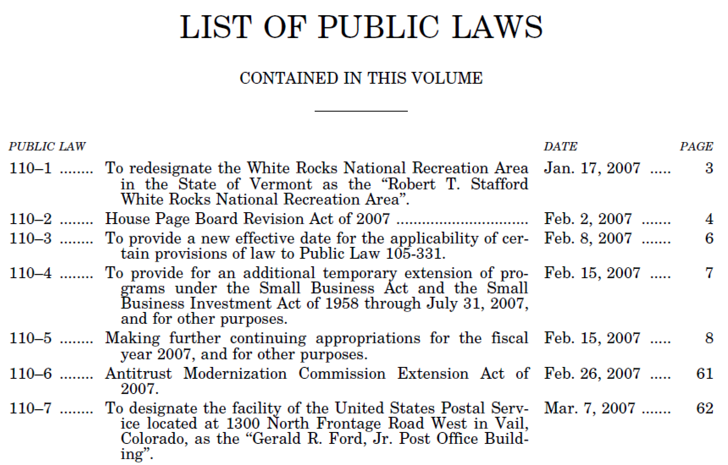
Statutes at Large - Lists

Slide 29
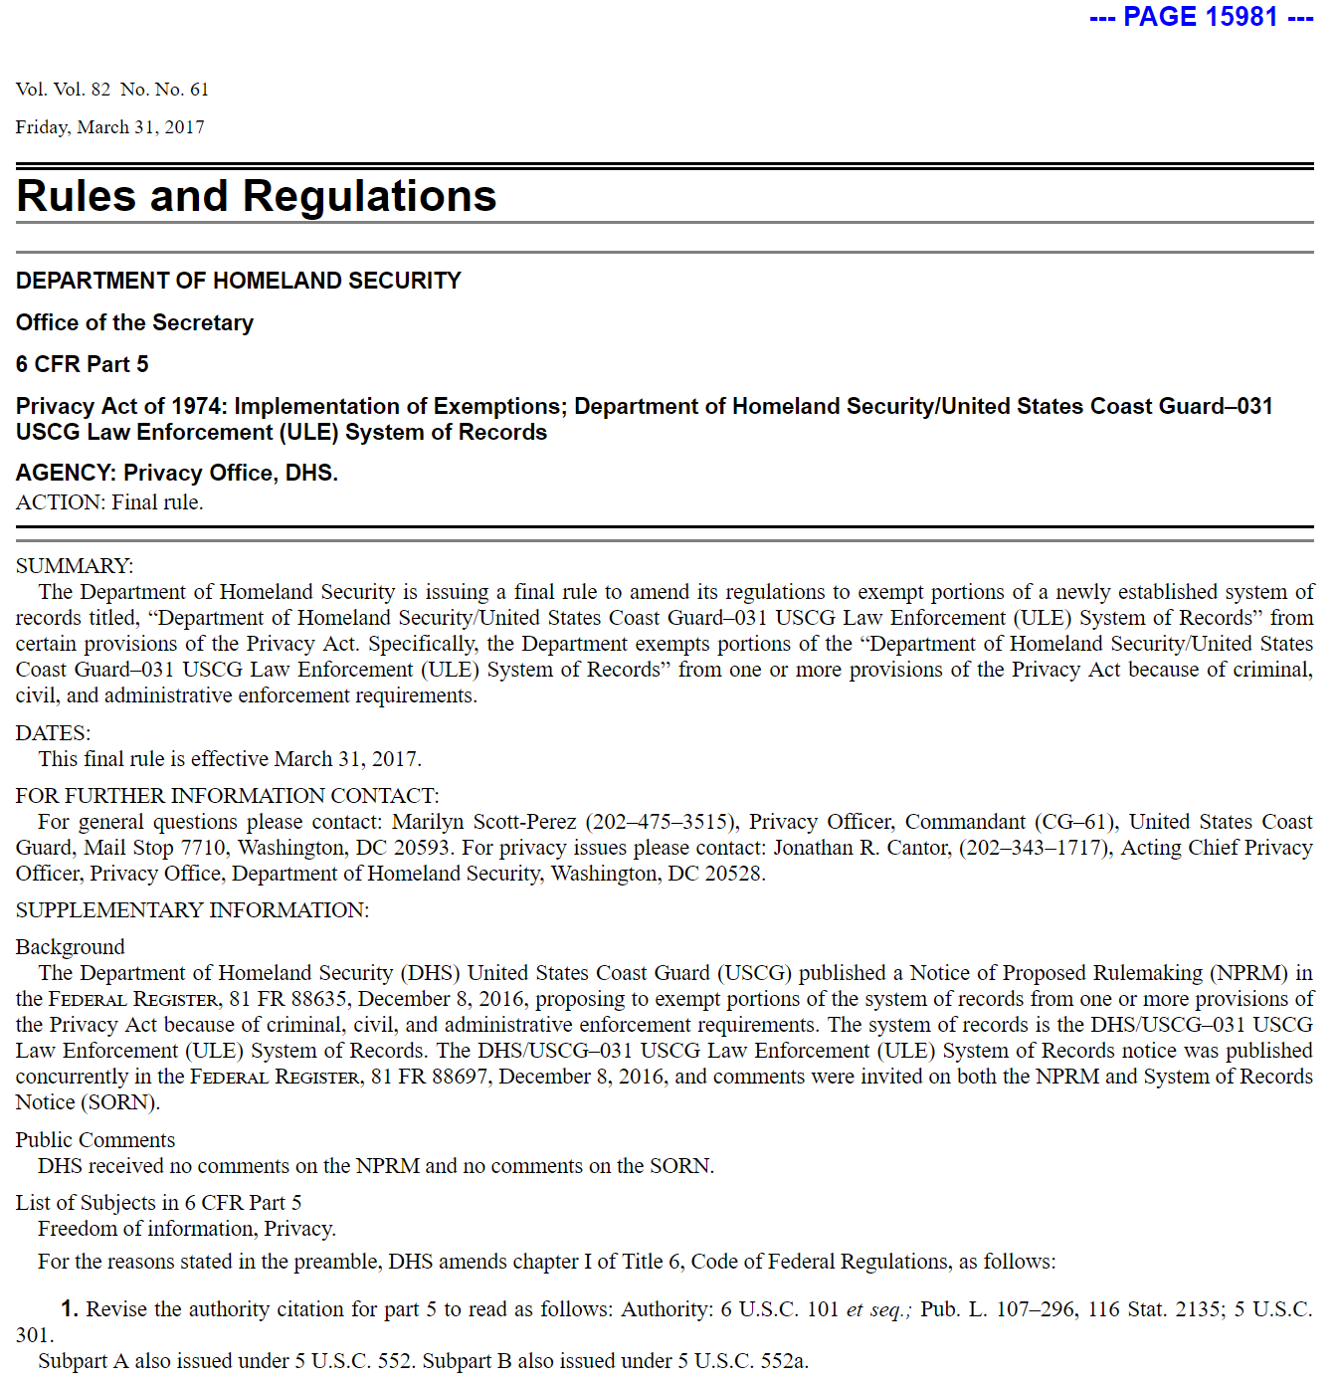
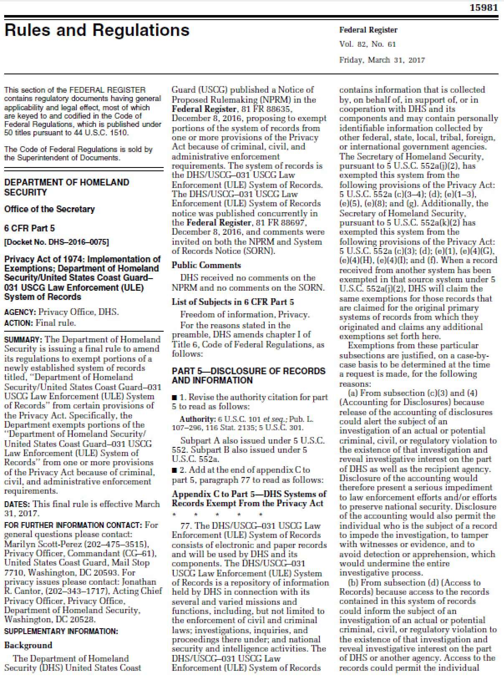
Federal Register
Federal Register Issue
Rules
Agency Group
Individual Rule

Slide 30
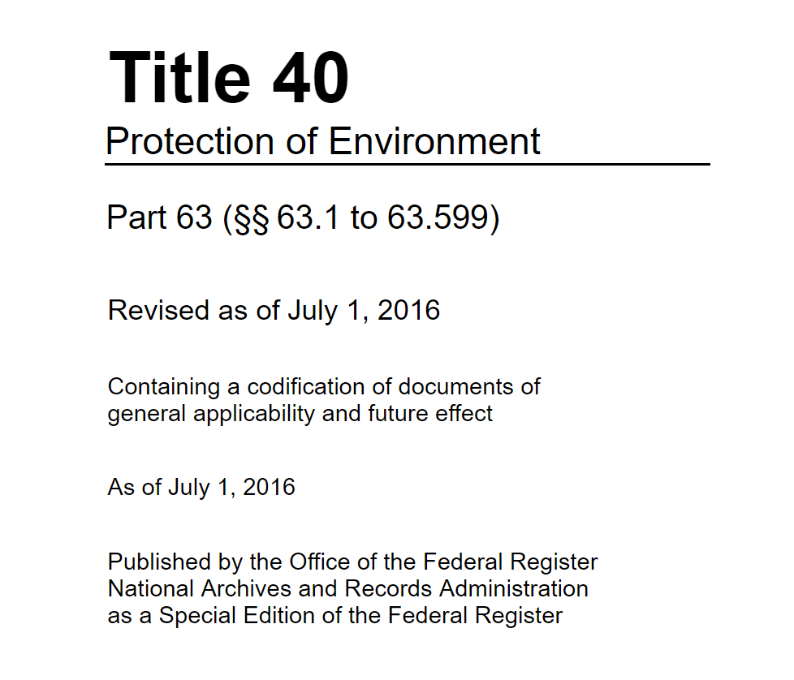
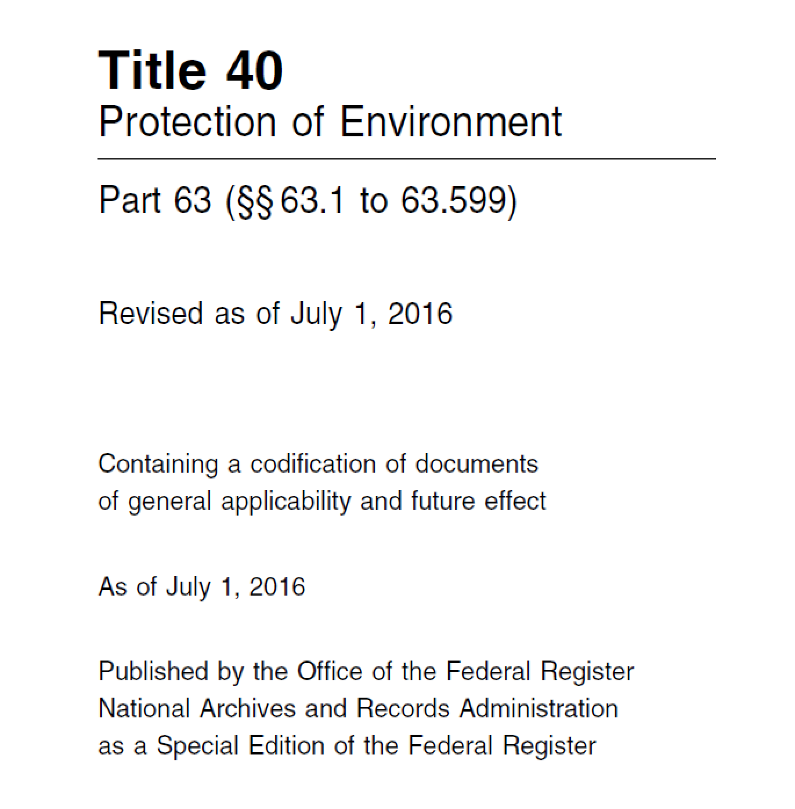
Code of Federal Regulations

Slide 31
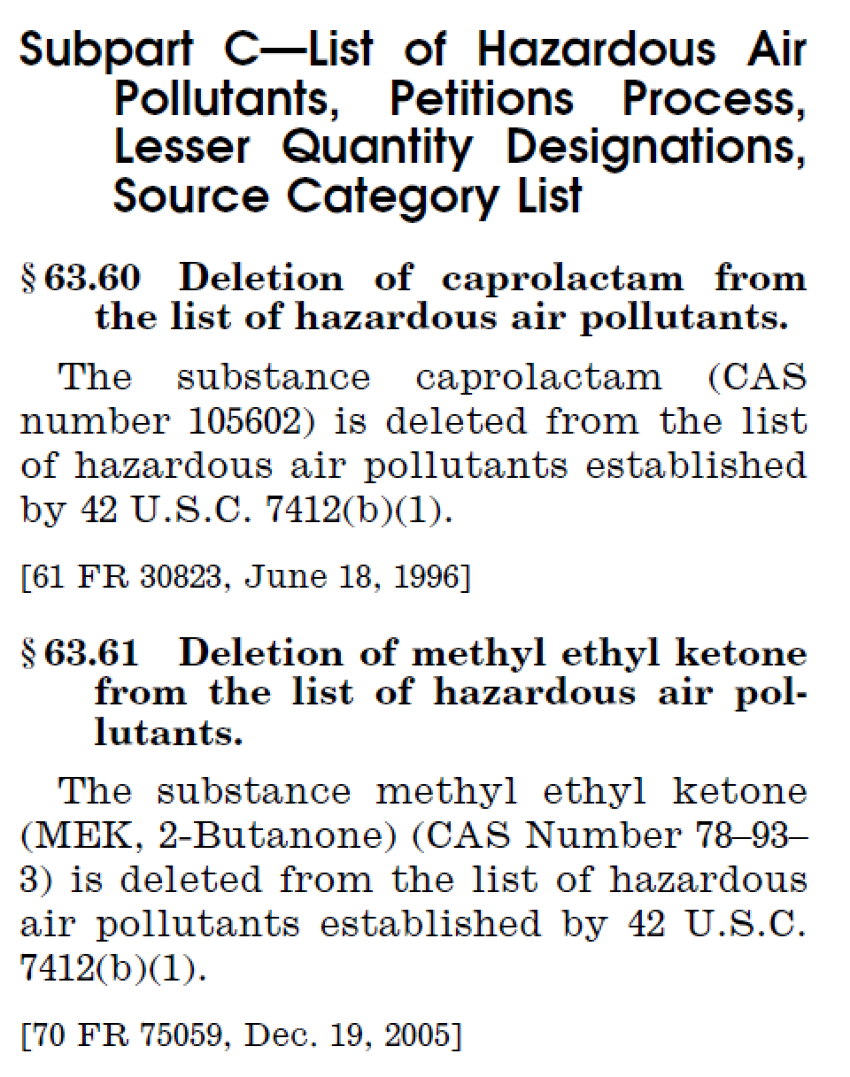
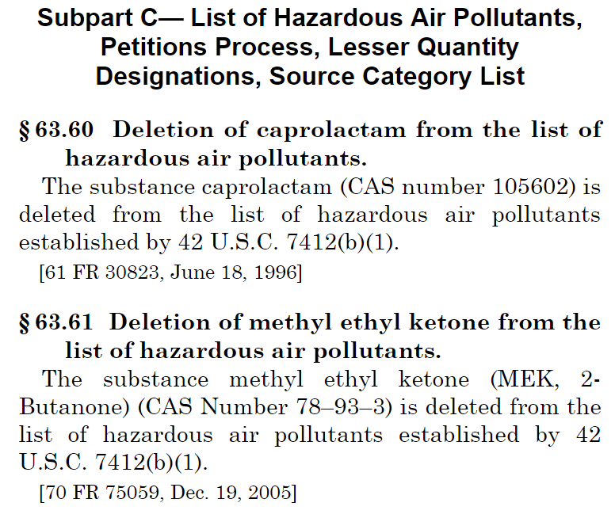
Code of Federal Regulations

Slide 32
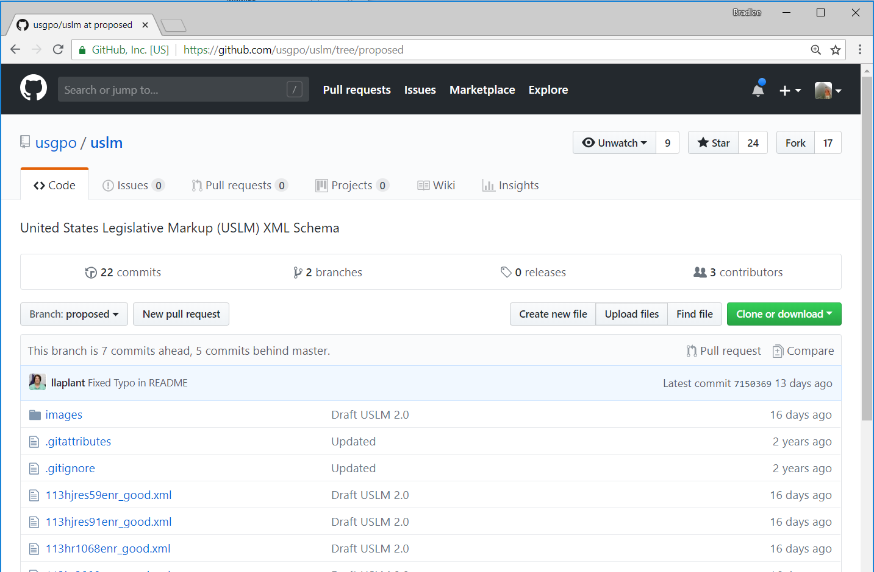
For More Information
https://github.com/usgpo/uslm
Proposed Branch
Draft 2.0 Schema
2.0 Review Guide
Sample Enrolled Bills
CSS for viewing

